Slide 1
Ethical Hacking
Mohona Ghosh

Slide 2
SQL Injection

Slide 3

What is SQL Injection ?
Structured Query Language (SQL) is basically a textual language that enables interaction with a database server
SQL commands such as INSERT, RETRIEVE, UPDATE, and DELETE are used to perform operations on the database. Programmers use these commands to manipulate data in the database server
SQL injection, also known as SQLI, is a common attack vector that uses malicious SQL code for backend database manipulation to access information that was not intended to be displayed
SQL injection takes advantage of non-validated input vulnerabilities and injects SQL commands through a web application that are executed in a back-end database

Slide 4

What is SQL Injection ?
Programmers use SQL commands with client-supplied parameters making it easier for attackers to inject commands
Attackers use this technique to either gain unauthorized access to a database or to retrieve information directly from the database
This information may include any number of items, including sensitive company data, user lists or private customer details
A successful attack may result in the unauthorized viewing of user lists, the deletion of entire tables and, in certain cases, the attacker gaining administrative rights to a database, all of which are highly detrimental to a business

Slide 5


Slide 6
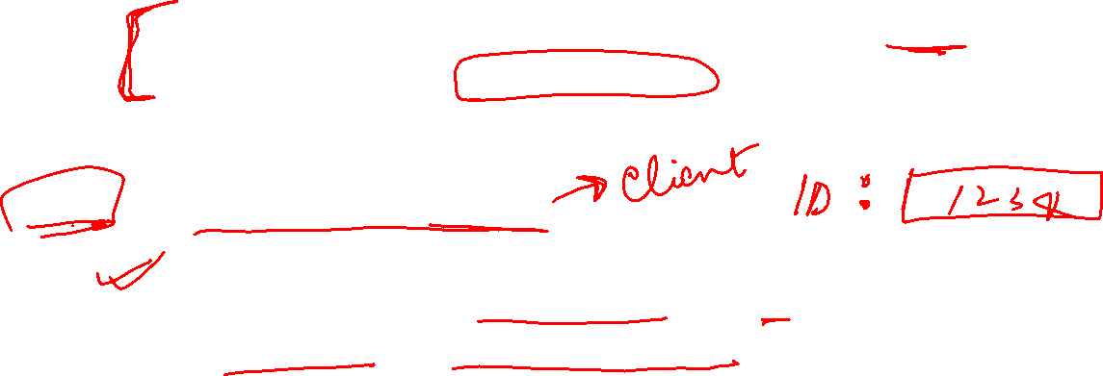
A typical case scenario
A typical eStore’s SQL database query may look like the following:
SELECT ItemName, ItemDescription FROM Item
WHERE ItemNumber = some number
From this, the web application builds a string query that is sent to the database as a single SQL statement:
ItemID = getRequestString(“itemid");
sql_query= " SELECT ItemName,ItemDescription
FROM Item WHERE ItemNumber = " &
Request.QueryString("ItemID")

Slide 7

A typical case scenario
When any user enters an input, the user-provided input http://www.estore.com/items/items.asp?itemid=999 will then generate the following SQL query:
SELECT ItemName, ItemDescription FROM Item WHERE ItemNumber = 999
The item details with item id 999 will be fetched and displayed

Slide 8
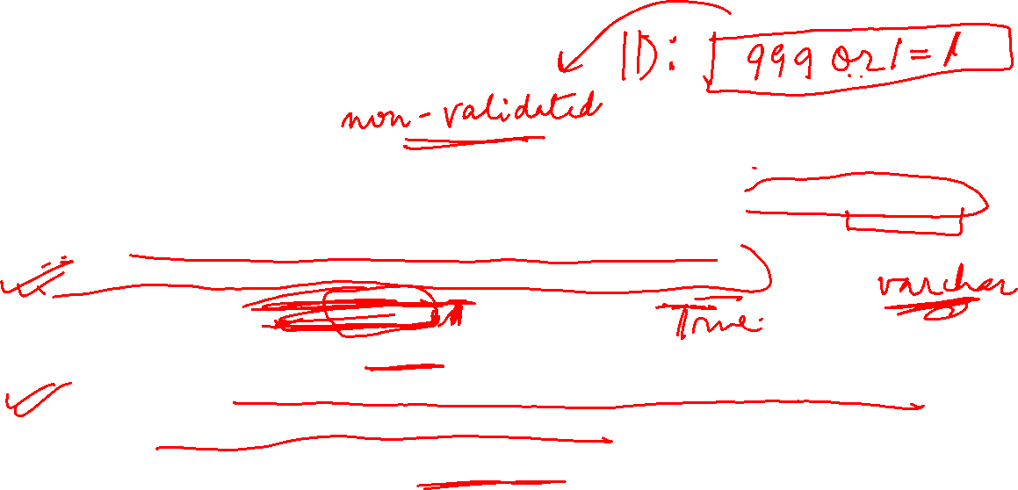
SQL Injection Examples
The previous example which pulls information for a specific product, can be altered to read http://www.estore.com/items/items.asp?itemid=999 or 1=1
As a result, the corresponding SQL query looks like this:
SELECT ItemName, ItemDescription FROM Items WHERE ItemNumber = 999 OR 1=1
Since the statement 1 = 1 is always true, the query will return ALL rows from the Items table displaying the product names and descriptions in the database even for those that you may not be eligible to access
What if the table would have contained names and passwords ?

Slide 9
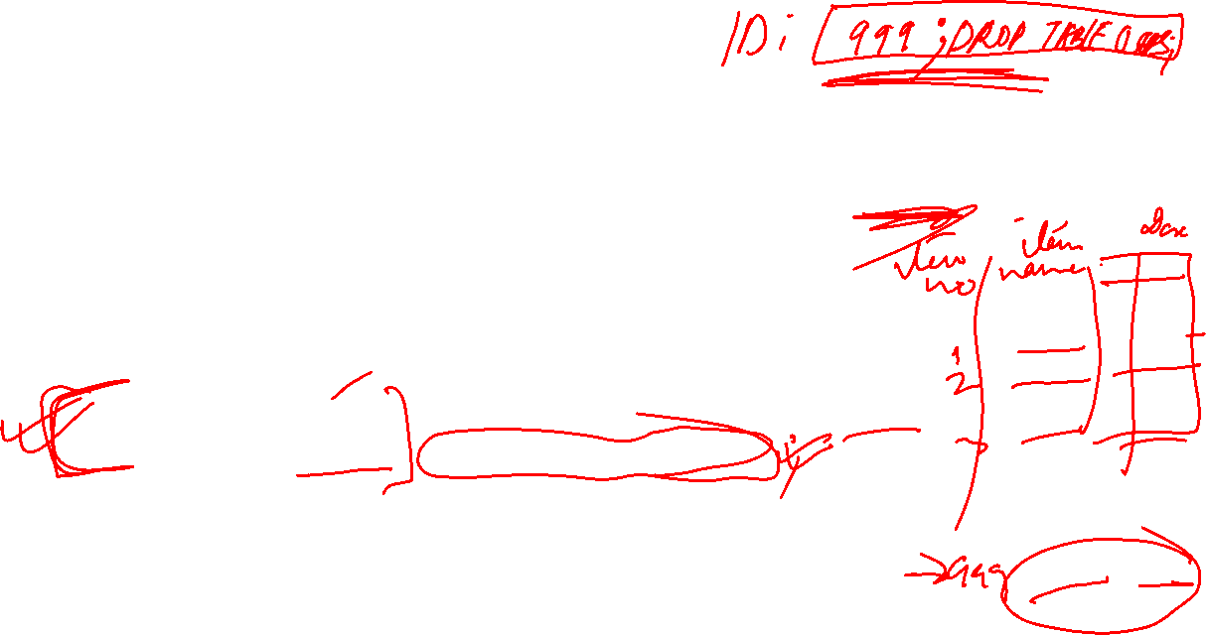
SQL Injection Examples
Attackers are also able to take advantage of incorrectly filtered characters to alter SQL commands, including using a semicolon to separate two fields.
For example, this input http://www.estore.com/items/iteams.asp?itemid=999; DROP TABLE Users would generate the following SQL query:
SELECT ItemName, ItemDescription FROM Items WHERE ItemNumber = 999; DROP TABLE USERS
As a result, the entire user database could be deleted.

Slide 10

SQL Injection Examples
Another way SQL queries can be manipulated is with a UNION SELECT statement. This combines two unrelated SELECT queries to retrieve data from different database tables
For example, the input http://www.estore.com/items/items.asp?itemid=999 UNION SELECT user-name, password FROM USERS produces the following SQL query:
SELECT ItemName, ItemDescription FROM Items WHERE ItemID = '999' UNION SELECT Username, Password FROM Users;
Using the UNION SELECT statement, this query combines the request for item 999’s name and description with another that pulls names and passwords for every user in the database

Slide 11

SQL Injection Examples

Slide 12


Slide 14

Types of SQL Injection Attacks
Simple SQLI
Error based SQLI
Blind SQLI

Slide 15

Simple SQL Injection
A simple SQL injection script builds an SQL query by concatenating hard-coded strings together with a string entered by the user

Slide 16

Error based SQL Injection
Error-based SQLi is an SQL Injection technique that relies on error messages thrown by the database server to obtain information about the structure of the database
In some cases, error-based SQL injection alone is enough for an attacker to enumerate an entire database
In this attack, the attacker will type or send something to the server by URL and the server will show an error. After getting the error, the attacker will decide on who the next target will be.

Slide 17
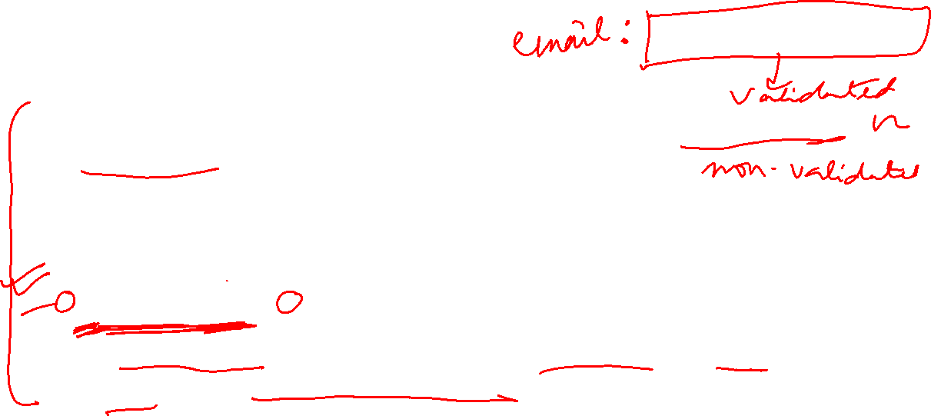
Error based SQL Injection
Suppose, the attacker wants to know if the website is prone to SQLI attack or not
Let us suppose, there is a SQL code at the backend that runs as follows:
SELECT data FROM table WHERE Emailinput = '$email_input';
The “$email_input” variable is used to hold whatever text the user inputs into the email address form field

Slide 18
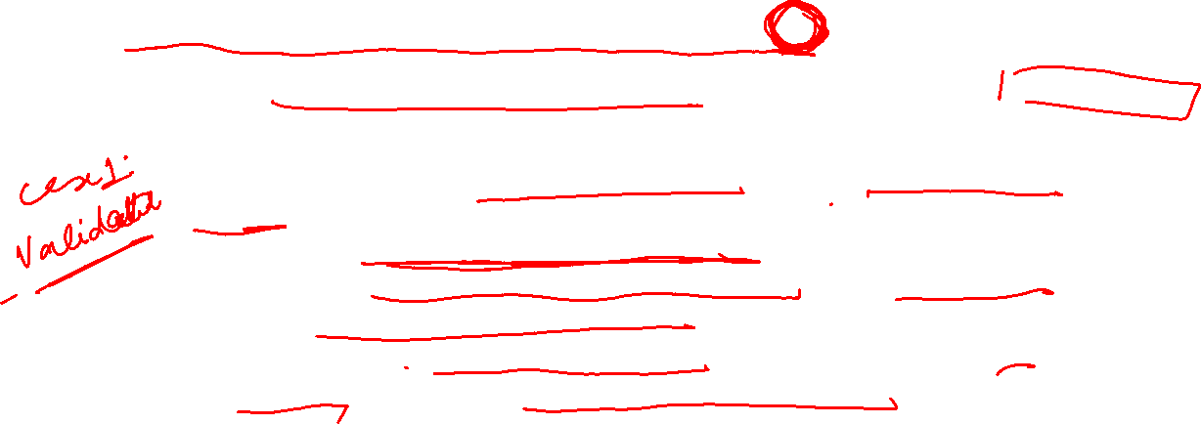
Error based SQL Injection
Suppose the attacker enters the following hacker@programmerinterview.com‘
Note the extra quote added at the end
There are basically 2 possibilities:
The application will first “sanitize” the input by removing the extra quote at the end, because we will assume that the application considers email addresses with quotes as potentially malicious. Then, the application may run the sanitized input in the database query, and search for that particular email address in the database (without the quote of course).
The application will not sanitize the input first, and will take the input from the hacker and immediately run it as part of the SQL.

Slide 19
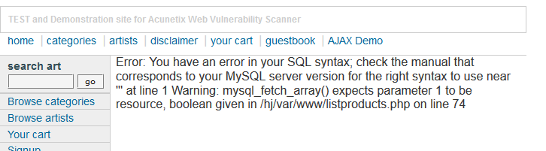
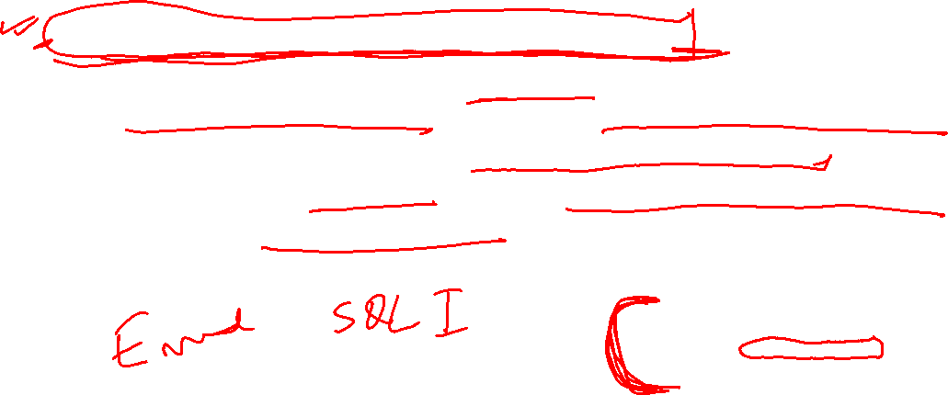
Error based SQL Injection
If this happens, the SQL being run by the application would look like this:
SELECT data FROM table WHERE Emailinput = 'hacker@programmerinterview.com'';
When this query is executed, SQL parser would see that there is an extra quote mark at the end, and it will abort with a syntax error.
An internal error or database error message would be shown
The error response is the key and tells the hacker that the input to the database is not being sanitized, i.e., the database can be exploited using SQLI attack

Slide 20
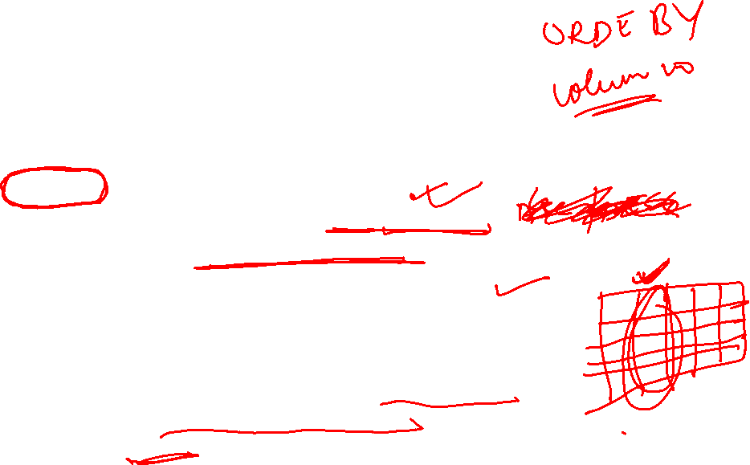
Error based SQL Injection
E.g., suppose in the previous example, the attacker wants to know how many columns the “items” database has ..
He can use the ORDER BY SQL Query as follows ..
http://www.estore.com/items/items.asp?itemid=999 ORDER BY 1
If no error is thrown, this means the table has one column. The attacker continues as follows:
http://www.estore.com/items/items.asp?itemid=999 ORDER BY 2
http://www.estore.com/items/items.asp?itemid=999 ORDER BY 3
………………………………….
http://www.estore.com/items/items.asp?itemid=999 ORDER BY 10
If the web server throws the unknown column error on 10, that means the “items” table has the total number of Columns 9 because it shows the content in order by 9.

Slide 21

Blind SQL Injection
In normal SQL injection, hackers rely on error messages returned from the database in order to give them some clues on how to proceed with their SQL injection attack
But with blind SQL injection the hacker does not need to see any error messages in order to run his/her attack on the database – and that is exactly why it is called blind SQL injection, i.e., even if the database error messages are turned off, a hacker can still run a blind SQL injection attack.

Slide 22

Blind SQL Injection

Slide 23
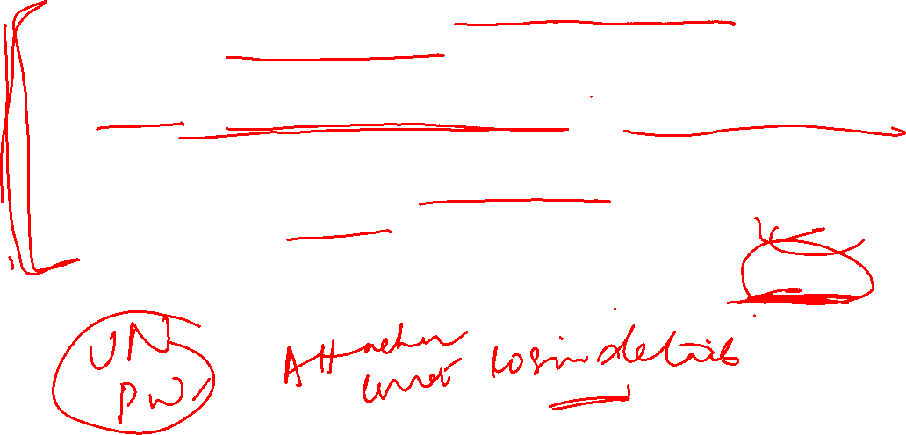
Blind SQL Injection
Let’s suppose that we have a fake example social networking site – let’s call it mybigspace.com – that has different profiles for people (just like Facebook). Each user on the site mybigspace.com has a unique ID number assigned to them that identifies their profile. And, a query string is used to retrieve each individual’s profile – so in the URL below, the user with an ID of 1008 will be pulled up and displayed on the page
http://www.mybigspace.com?id=1008

Slide 24
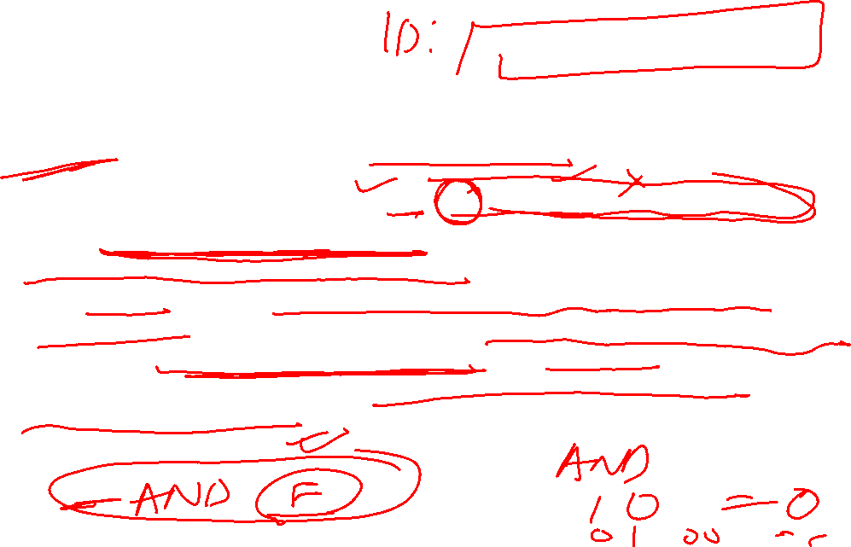
Blind SQL Injection
Suppose, the attacker wants to check if the server is running MySQL version 5. He will submit the following query
http://www.mybigspace.com?id=1008 AND substring(@@version, 1, 1)=5
The SQL “substring(@@version, 1, 1)=5” just checks to see if the version of MySQL that is currently running is version 5 (through the “=5” check), and if it is running version 5 then the page will just load normally because the SQL will run without a problem. If mybigspace.com’s server is not running MySQL version 5 then the SQL “substring(@@version, 1, 1)=5” will return false because the check for equality is false. This means that the page will probably not load because the profile will not be retrieved, and so the hacker knows that the version of MySQL being run is not version 5.

Slide 25

How to defend against SQL Injection attacks ?
Trust no one: Assume all user-submitted data is evil so use input validation via a function such as MySQL's mysql_real_escape_string() to ensure that any dangerous characters such as ' are not passed to a SQL query in data. You should also sanitize everything by filtering user data by context. For example, email addresses should be filtered to allow only the characters allowed in an e-mail address, phone numbers should be filtered to allow only the digits allowed in a phone number, and so on.
Update and patch: Vulnerabilities in applications and databases that hackers can exploit using SQL injection are regularly discovered, so it's vital to apply patches and updates as soon as practical.

Slide 26
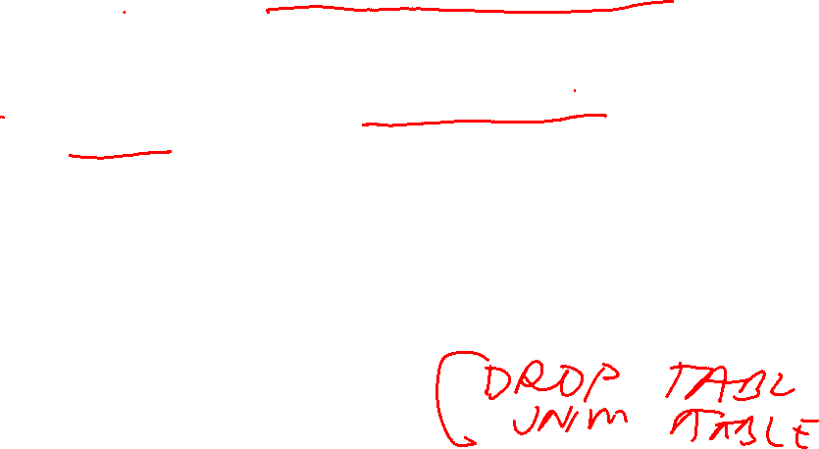
How to defend against SQL Injection attacks ?
Reduce your attack surface: Get rid of any database functionality that you don't need to prevent a hacker taking advantage of it.
Use appropriate privileges: Don't connect to your database using an account with admin-level privileges unless there is some compelling reason to do so. Using a limited access account is far safer, and can limit what a hacker is able to do. For example, the code behind a login page should query the database using an account limited only to the relevant credentials table. This way, a breach through this channel cannot be leveraged to compromise the entire database.
Keep your secrets secret: Assume that your application is not secure and act accordingly by encrypting or hashing passwords and other confidential data, including connection strings.

Slide 27

How to defend against SQL Injection attacks ?
Don't divulge more information than you need to: Hackers can learn a great deal about database architecture from error messages, so ensure that they display minimal information. Use the "RemoteOnly" customErrors mode (or equivalent) to display verbose error messages on the local machine while ensuring that an external hacker gets nothing more than the fact that his or her actions resulted in an unhandled error
Buy better software: Make code writers responsible for checking the code and for fixing security flaws in custom applications before the software is delivered. E.g., the coder can use software such as The Microsoft Source Code Analyzer for SQL Injection tool. This is a static code analysis tool that helps you find SQL injection vulnerabilities in Active Server Pages (ASP) code. It scans ASP source code and generates warnings related to SQL injection vulnerabilities

